Slide 1


22AIE302 – INTRODUCTION TO DEEP LEARNING
"Hybrid Approach for Animal Breed Classification Using EfficientNetBO: A Deep Learning Model for Multi-Class Image Recognition"
Team - 17
SAI MANOJ KUMAR – CH.EN.U4AIE22040
POTHALA MOKSHAJNA VENKATA KRUSHNA - CH.EN.U4AIE22041

Slide 2
PROBLEM STATEMENT
In animal care, veterinary services, and animal management, accurately identifying animal breeds is critical for providing the best care and managing breed-specific needs. However, manually classifying animal breeds is challenging due to the subtle differences among certain breeds, especially for images of similar-looking cats and dogs. The objective of this project is to automate animal breed classification using advanced deep learning techniques, enhancing accuracy and efficiency in breed identification.
2

Slide 3
OBJECTIVE
To develop a deep learning model that accurately classifies cat and dog breeds from images.
To evaluate EfficientNetB0's performance against other models (InceptionV3, MobileNetV2, ResNet50) in terms of accuracy and resource efficiency.
To achieve over 90% accuracy, making the model robust and reliable for practical animal breed identification.
3

Slide 4
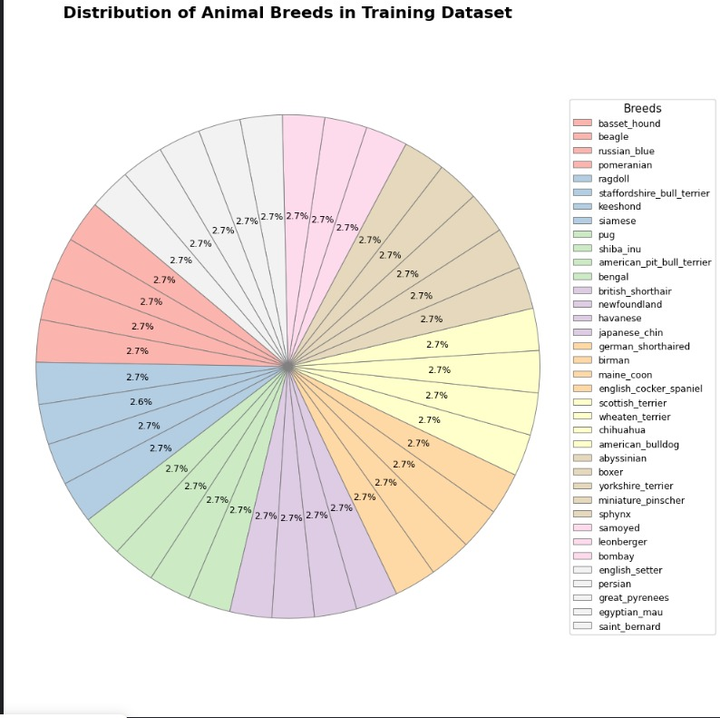
DATASET
Source & Structure:
Dataset Source: Kaggle (multi-class breed classification for cats and dogs).
Folders:
Training Folder: 37 breeds, 159 images per breed, labeled for fine-grained supervised classification.
Test Folder: Unlabeled images simulate real-world scenarios without predefined breed identifiers.
Class Diversity & Realism:
Includes diverse backgrounds, lighting, angles, and poses to mimic natural conditions and improve model resilience.
Data Augmentation:
Techniques: Random Rotation, Flipping, and Scaling.
Purpose: Expands data variability, reduces overfitting, enhances generalization and robustness in breed detection.
4

Slide 5
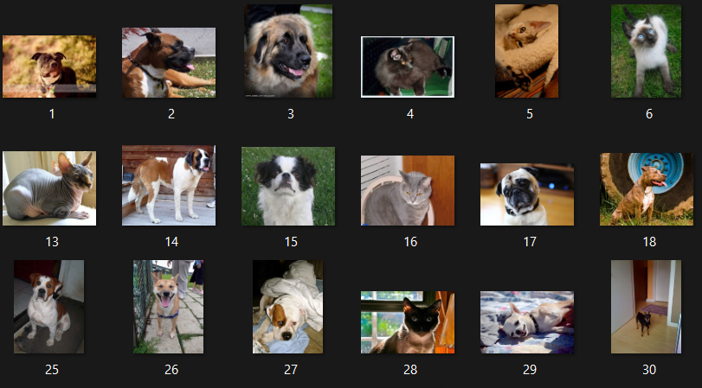
DATASET
The test dataset contains a set of unlabeled data the images of cats and dogs, numbered from 1 to 1500. Since these images lack ground truth labels, they can be used to evaluate the model’s predictions without direct accuracy metrics.
5

Slide 6
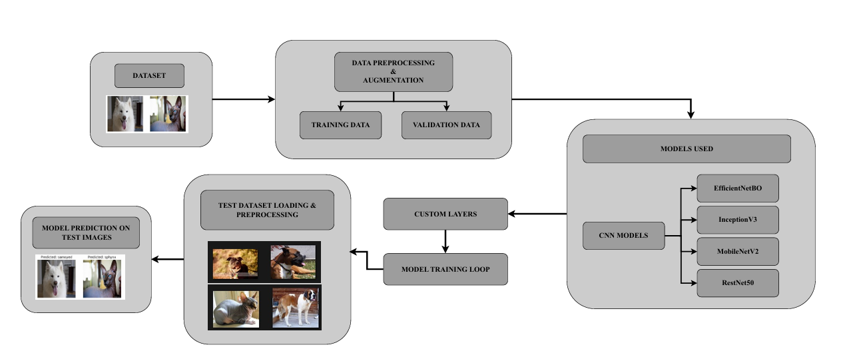
ARCHITECTURE DIAGRAM
6

Slide 7
METHODOLOGY
Data Preparation and Model Selection
Data Collection
Dataset from Kaggle: 37 breed classes of cats and dogs.
Train Set: 159 images per breed in labeled classes; Test Set: Unlabeled images.
Data Preprocessing
Image Resizing & Normalization: Standardized input for efficient model processing.
Data Augmentation: Applied rotation, flipping, zooming, and contrast changes to improve model robustness.
Model Selection
EfficientNetB0: Chosen as the primary model for its high accuracy and computational efficiency.
Benchmark Models:
ResNet50: Known for deep layers to capture detailed features.
InceptionV3: Handles multiple spatial scales for intricate feature extraction.
MobileNetV2: Lightweight and optimized for mobile and embedded applications.
7

Slide 8
METHODOLOGY
Model Training and Results
EfficientNetB0 Enhancements: Added layers for improved performance:
GlobalAveragePooling2D, Batch Normalization, Dropout, and Dense Layers.
Training and Validation
Validation split: 20% of training data used for validation.
Training without early stopping; increased epochs for thorough learning.
Accuracy
Achieved 90% validation accuracy with EfficientNetB0; comparison:
EfficientNetB0: 90% accuracy
ResNet50: 87% accuracy
InceptionV3: 89% accuracy
MobileNetV2: 85% accuracy
8

Slide 9
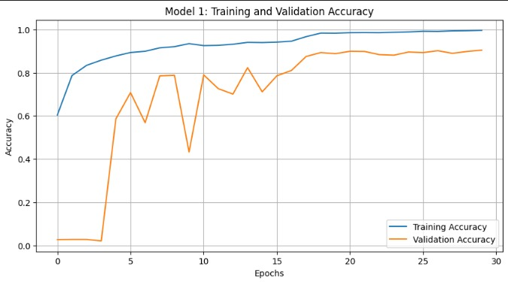
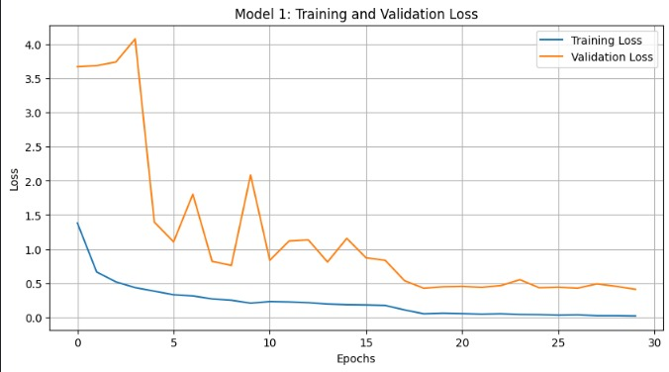
RESULTS
Model -1 EfficientNetBO Training and Validation Accuracy and Loss
9

Slide 10
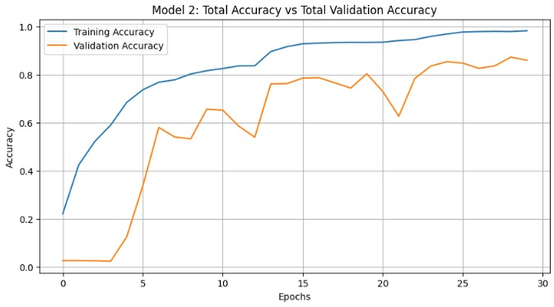
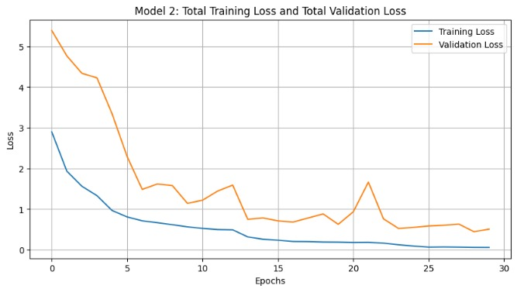
RESULTS
Model – 2 Resnet Training and Validation Accuracy and Loss
10

Slide 11
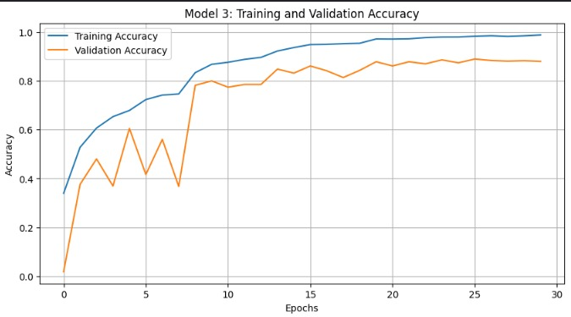
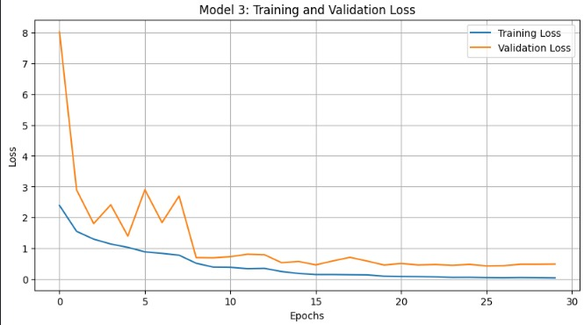
RESULTS
Model – 3 InceptionV3 Training and Validation Accuracy and Loss
11

Slide 12
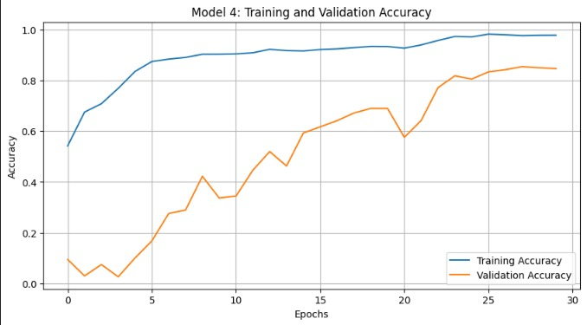
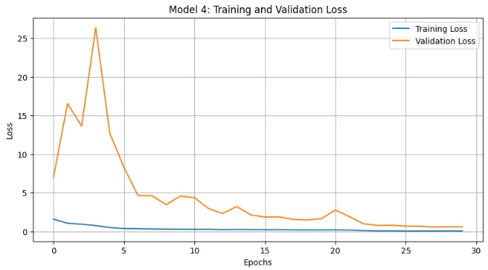
RESULTS
Model – 4 MobileNetV2 Training and Validation Accuracy and Loss
12

Slide 13
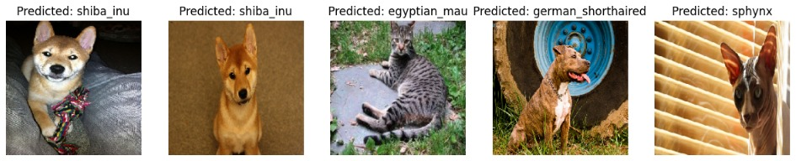
RESULTS
Predicted breeds from test images
13

Slide 14
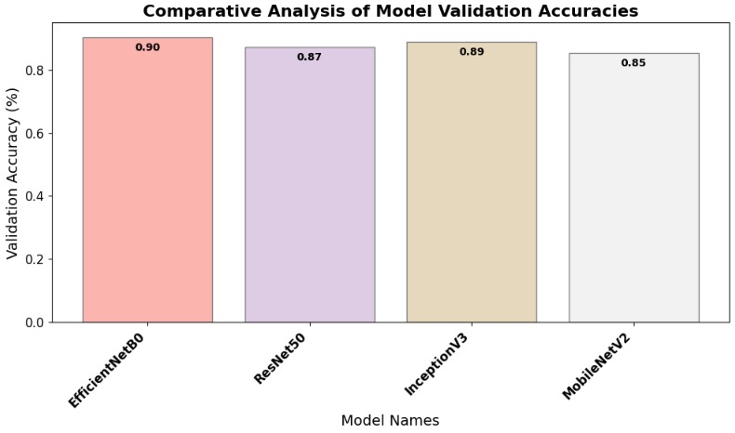
RESULTS
Comparitive Analysis
14

Slide 15
THANK YOU
15

